Slide 1


Streamline Development
Leveraging Child and Grandchild Themes

Slide 2


Slide 3
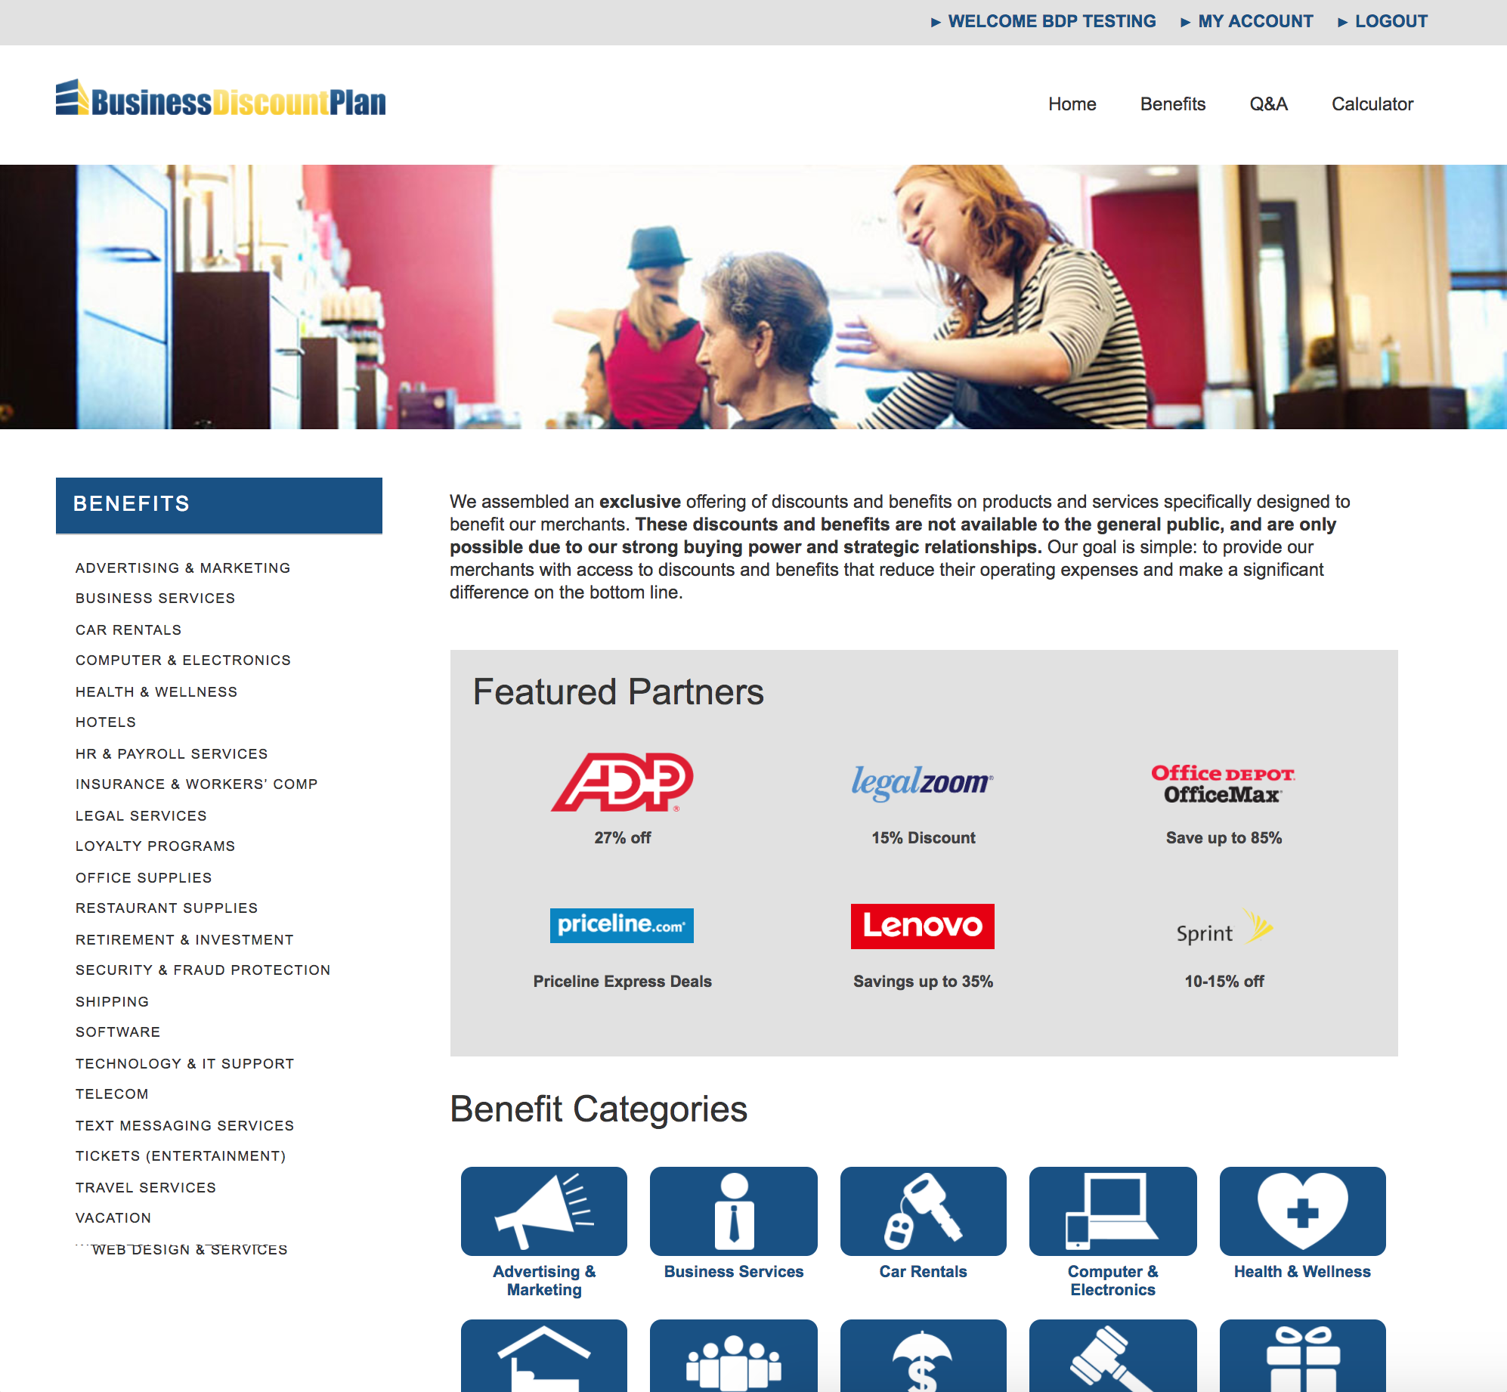
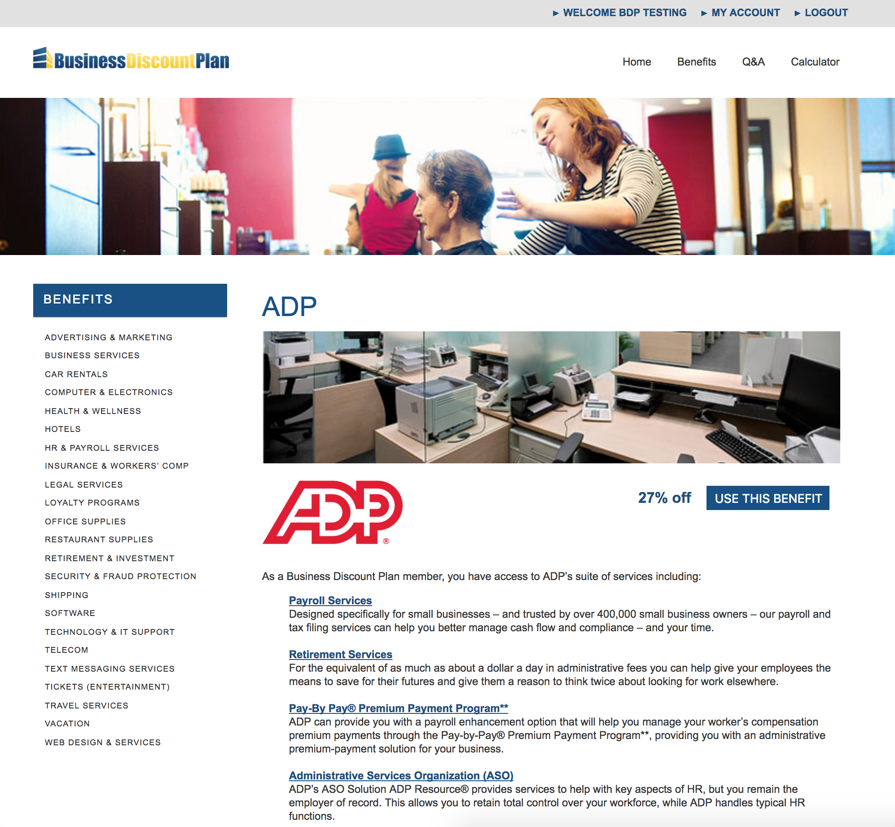

Slide 5
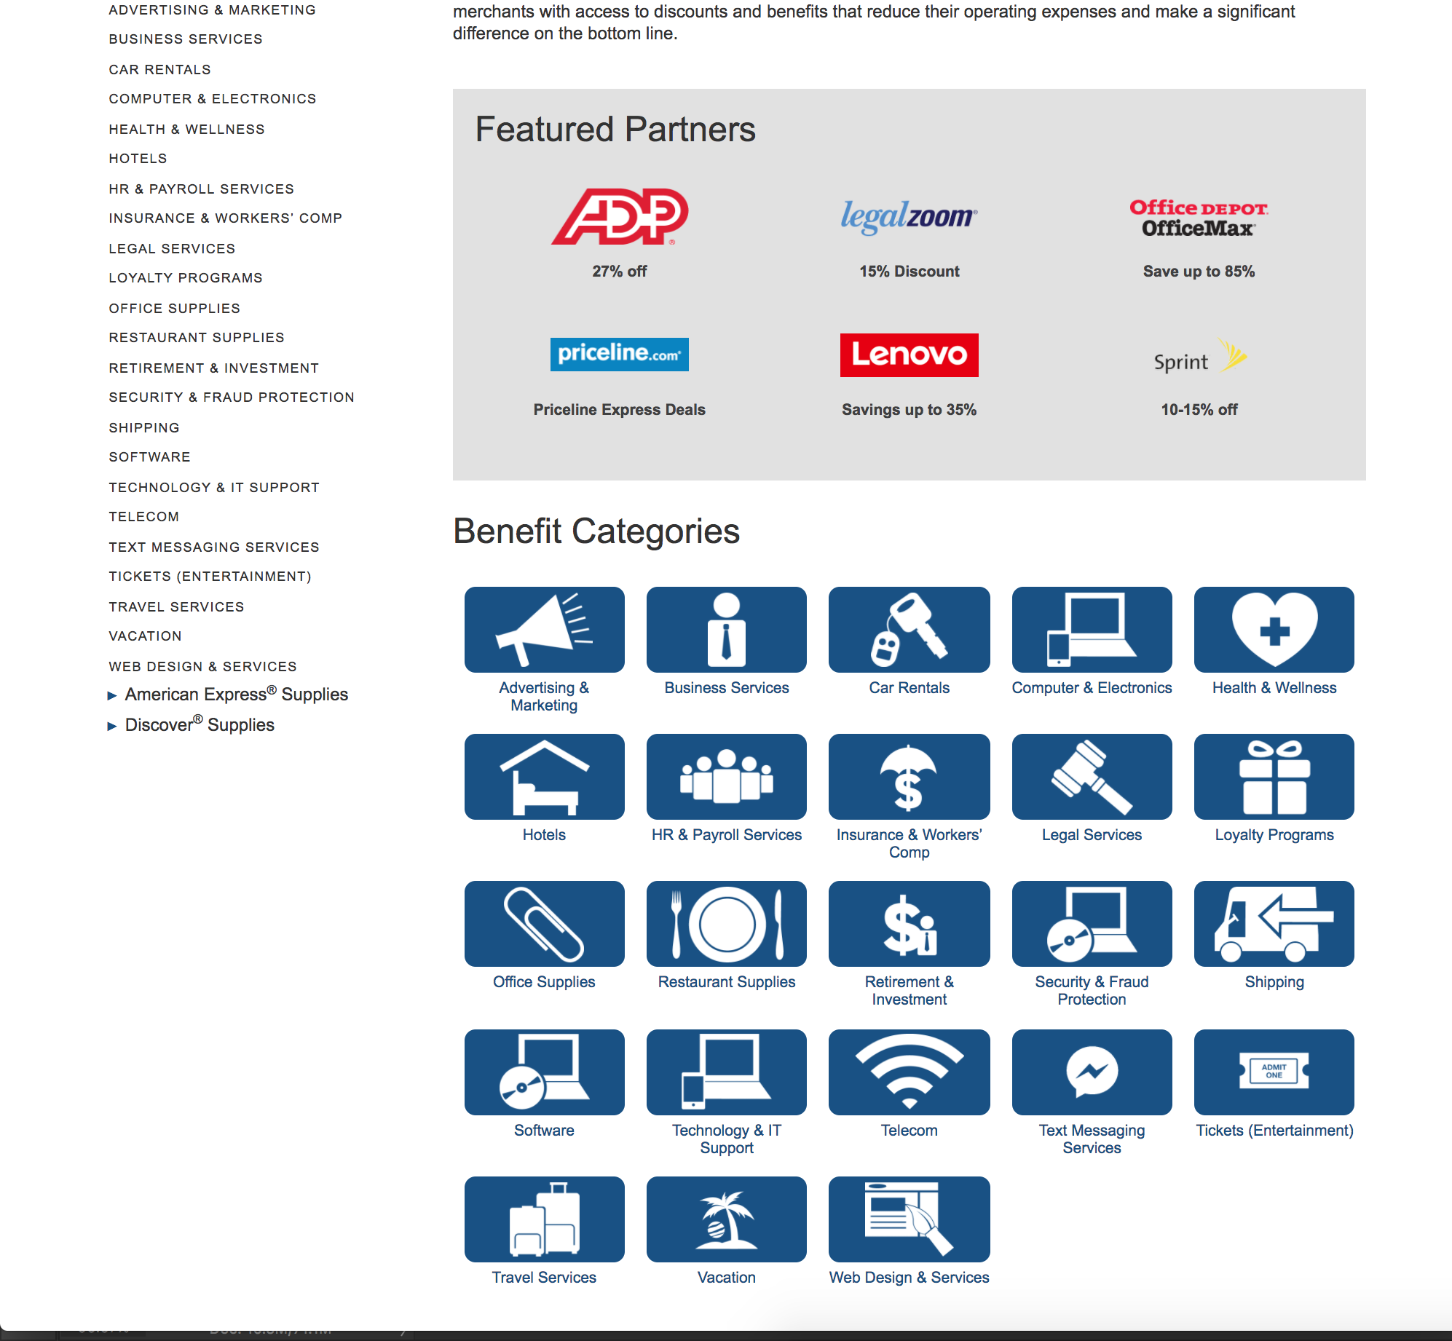

Slide 7
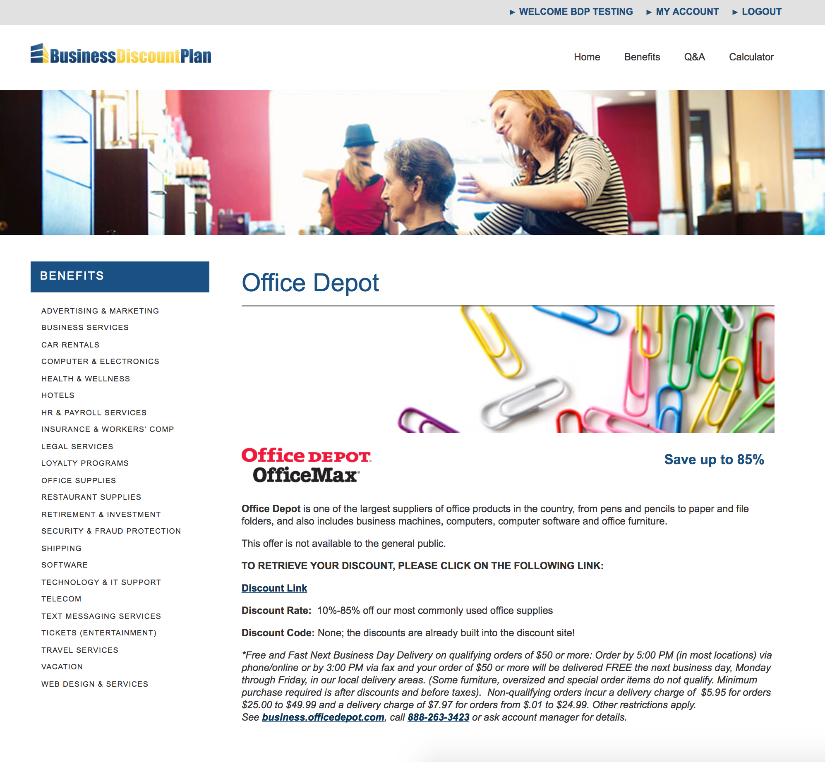

Slide 8


Slide 9


Slide 10
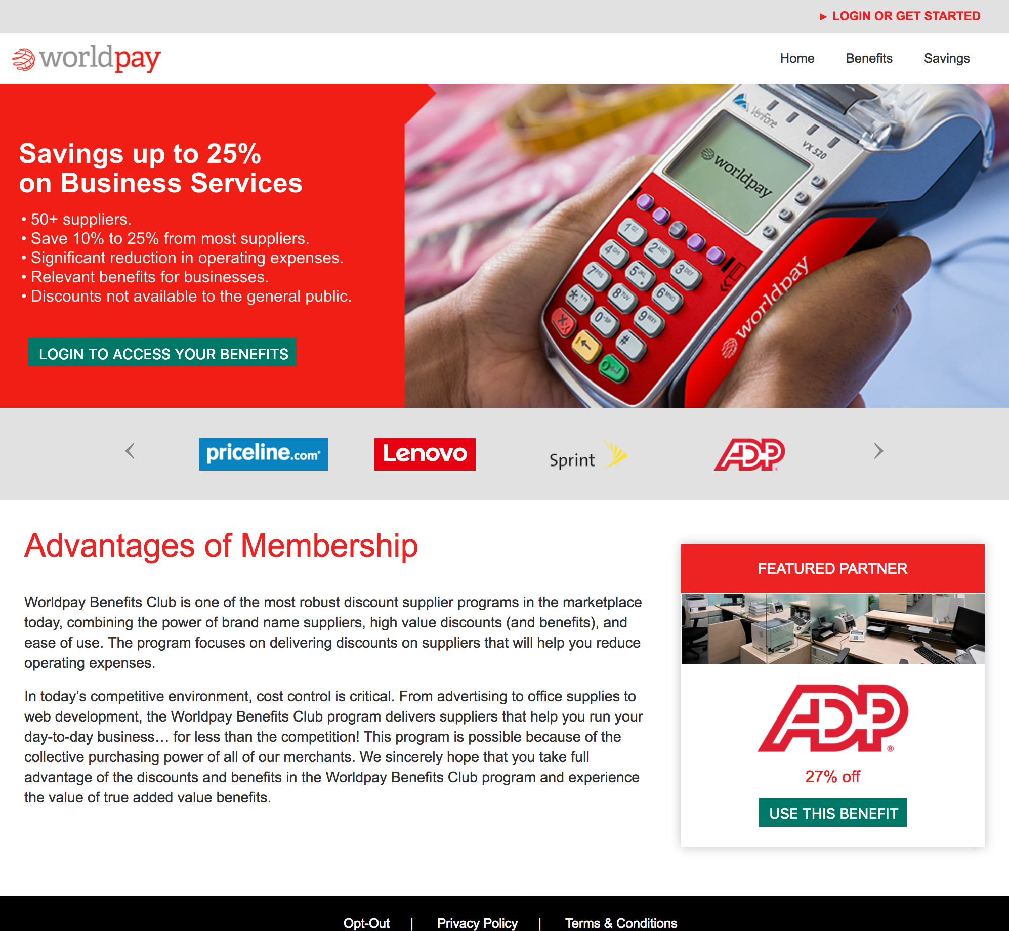

Slide 11
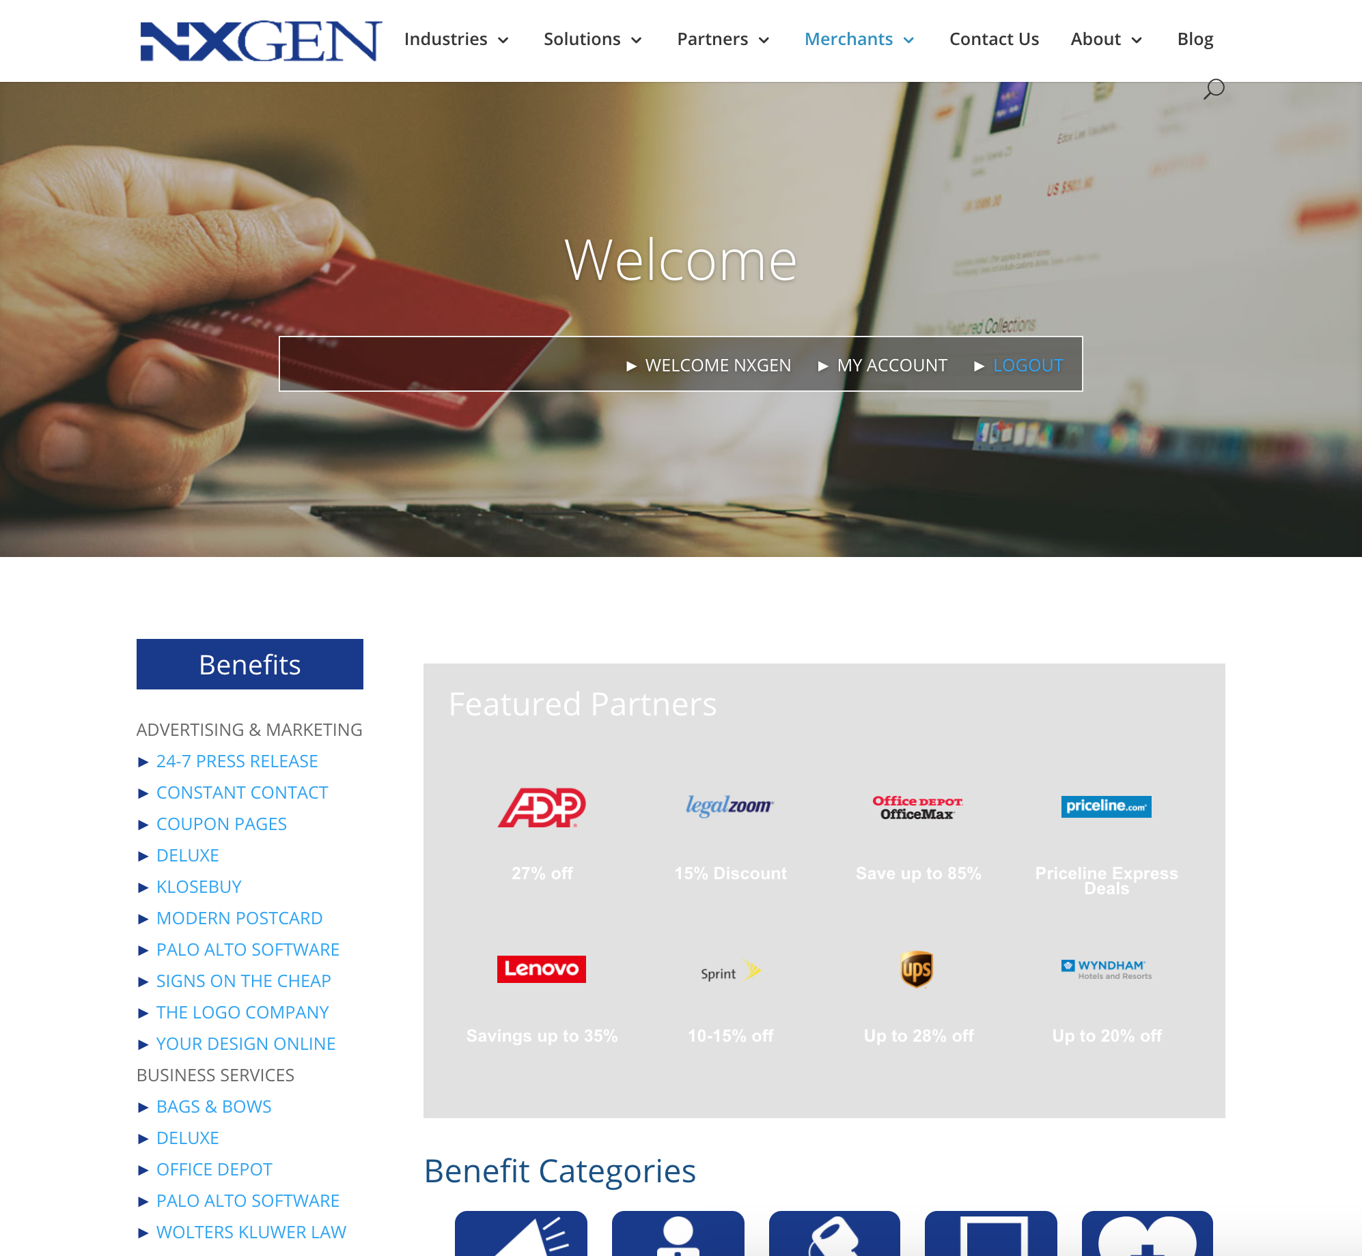

Slide 12

Front End
Member-facing portals, unique instances

Slide 13
Front End
Member-facing portals, unique instances
Manages Design, Layout

Slide 14
Front End
Member-facing portals, unique instances
Manages Design, Layout
Manages Updates: Core, Themes, Plugins

Slide 15
Back End
Authenticates Member Login

Slide 16
Back End
Authenticates Member Login
Serves Content Feed via API

Slide 17
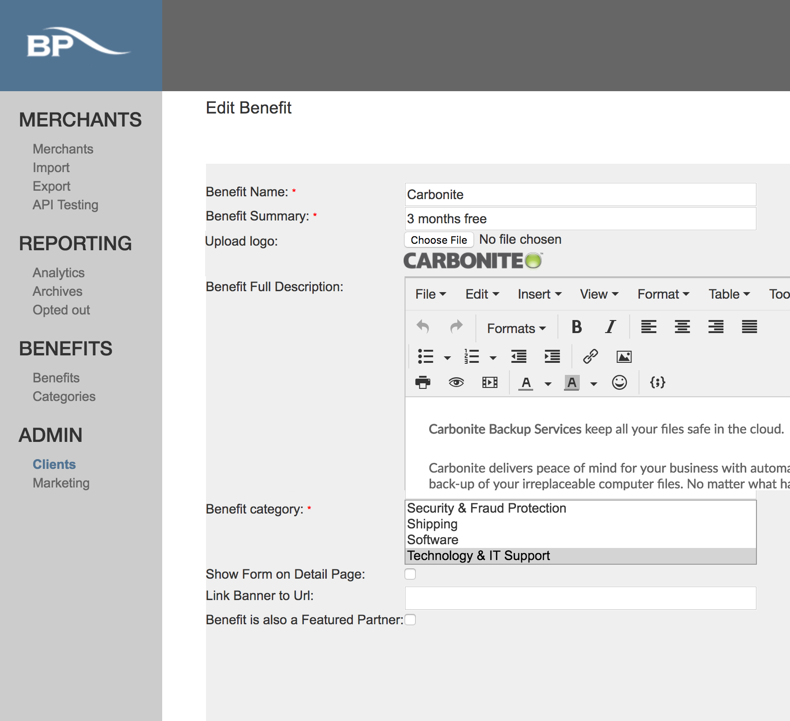
Brand Management: Je Portal
Vendor Management: Carbonite

Slide 18
Back End
Authenticates Member Login
Serves Content Feed via API
Serves Brand Information via API

Slide 19
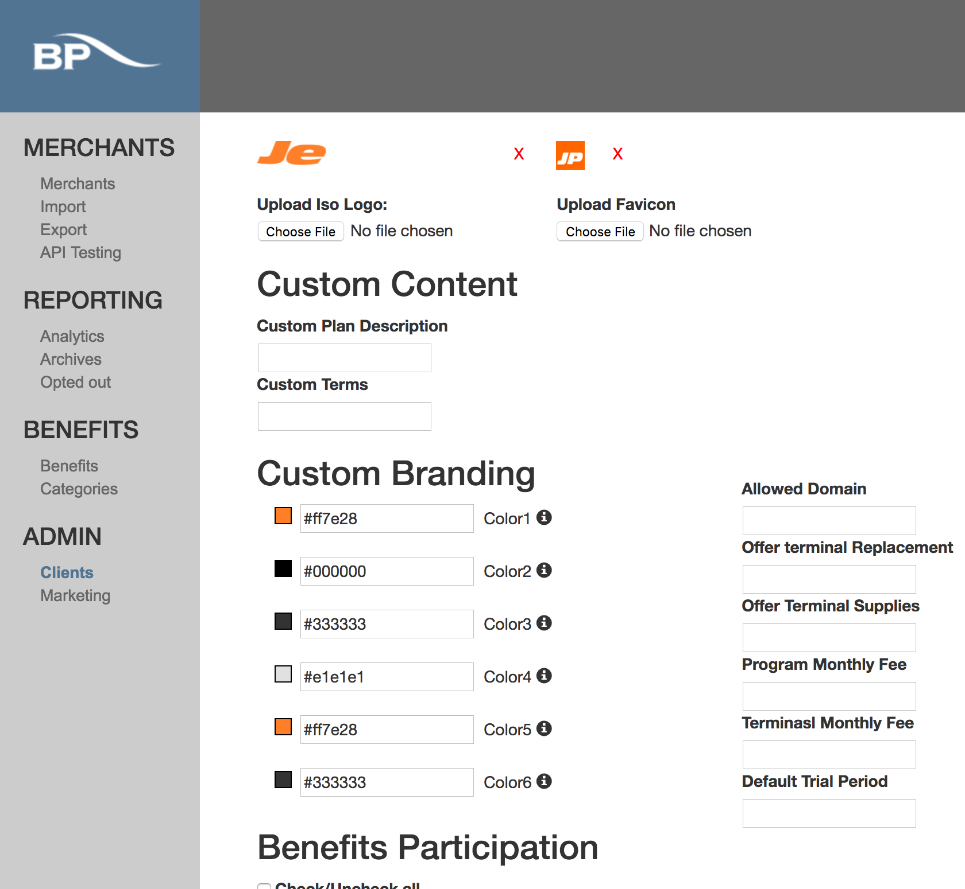
Brand Management: Je Portal

Slide 20
The Question:
How do we SCALE this?

Slide 21
The WordPress Environment
Parent Theme
Theme Functions, Updates
Child Theme
Global Design

Slide 22
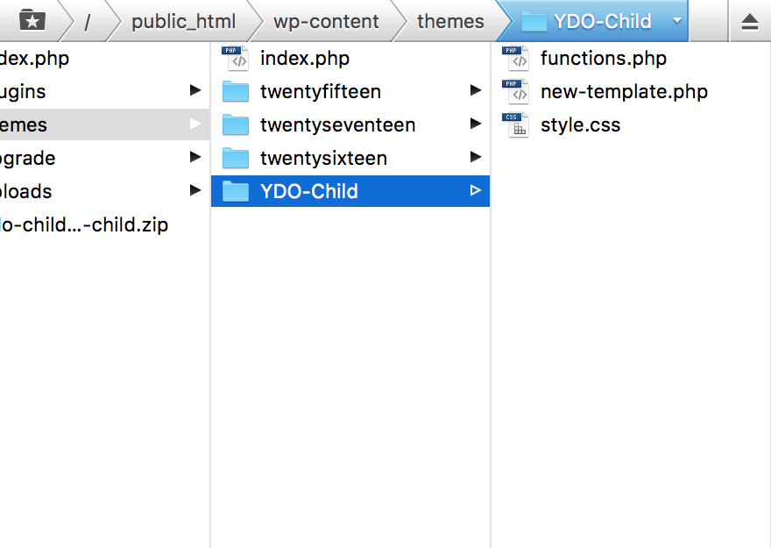

Slide 23
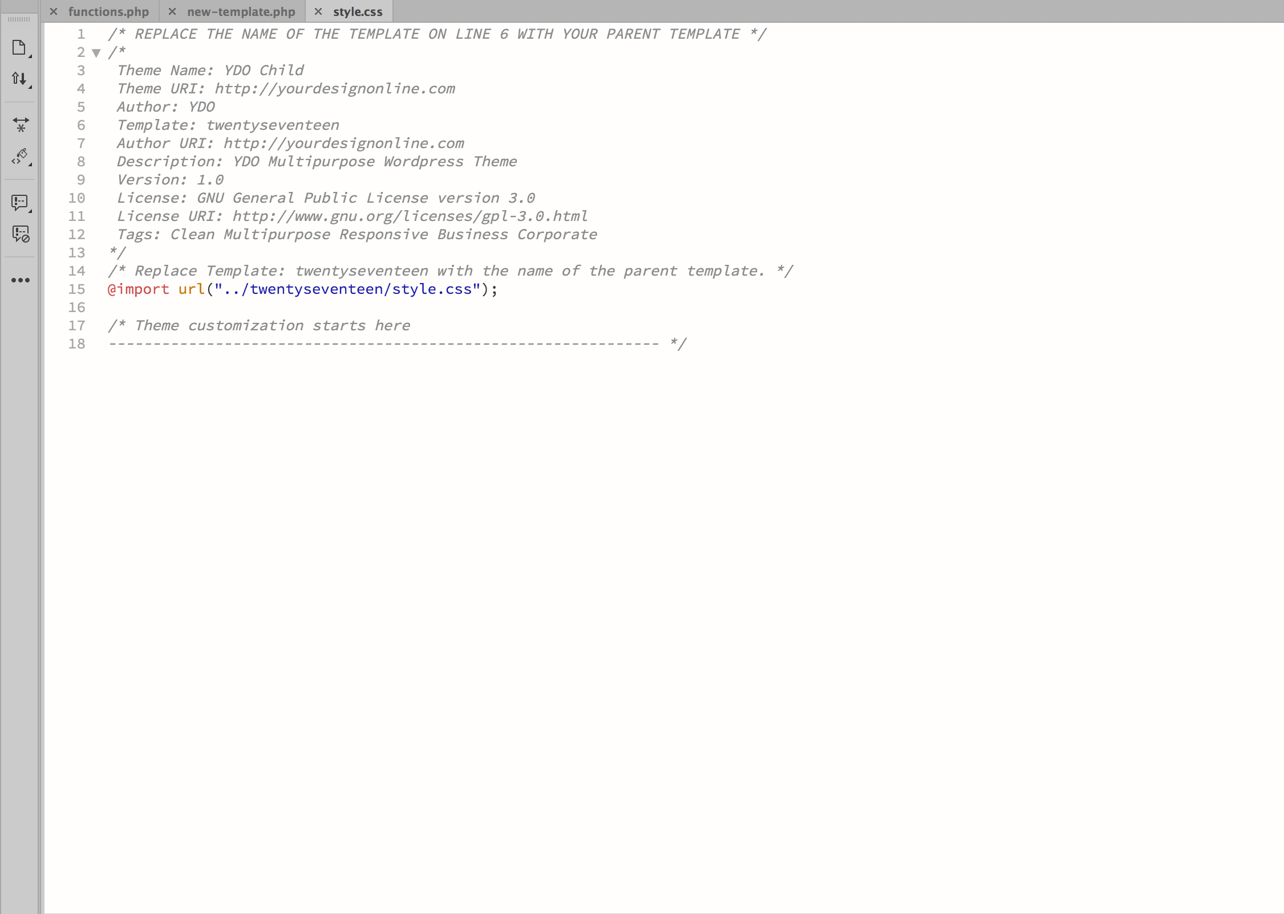
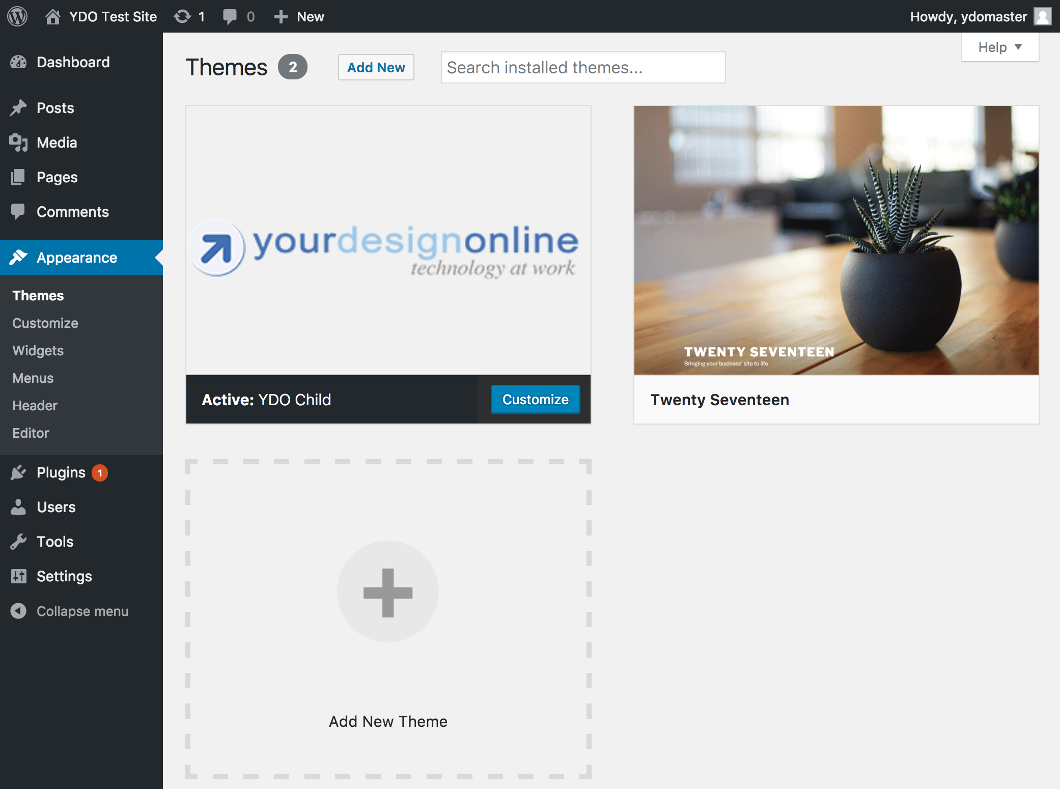

Slide 25
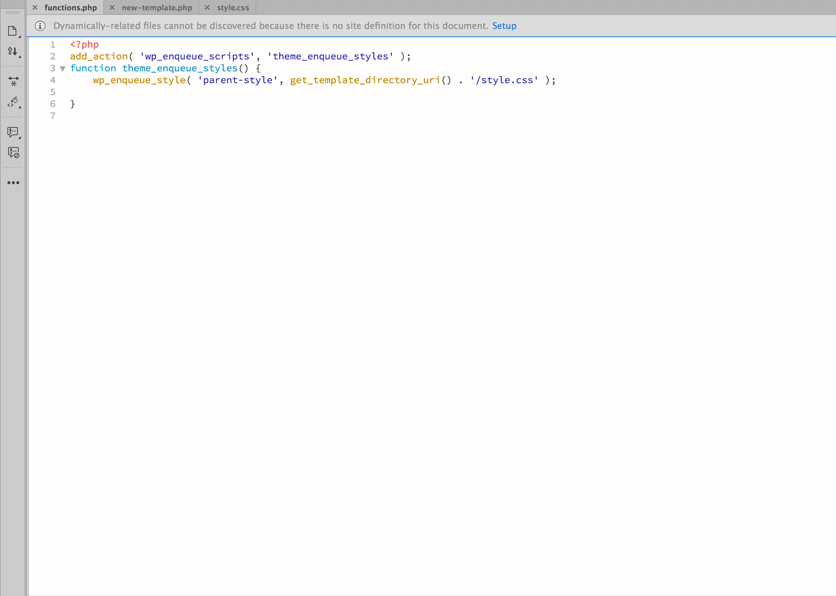

Slide 26
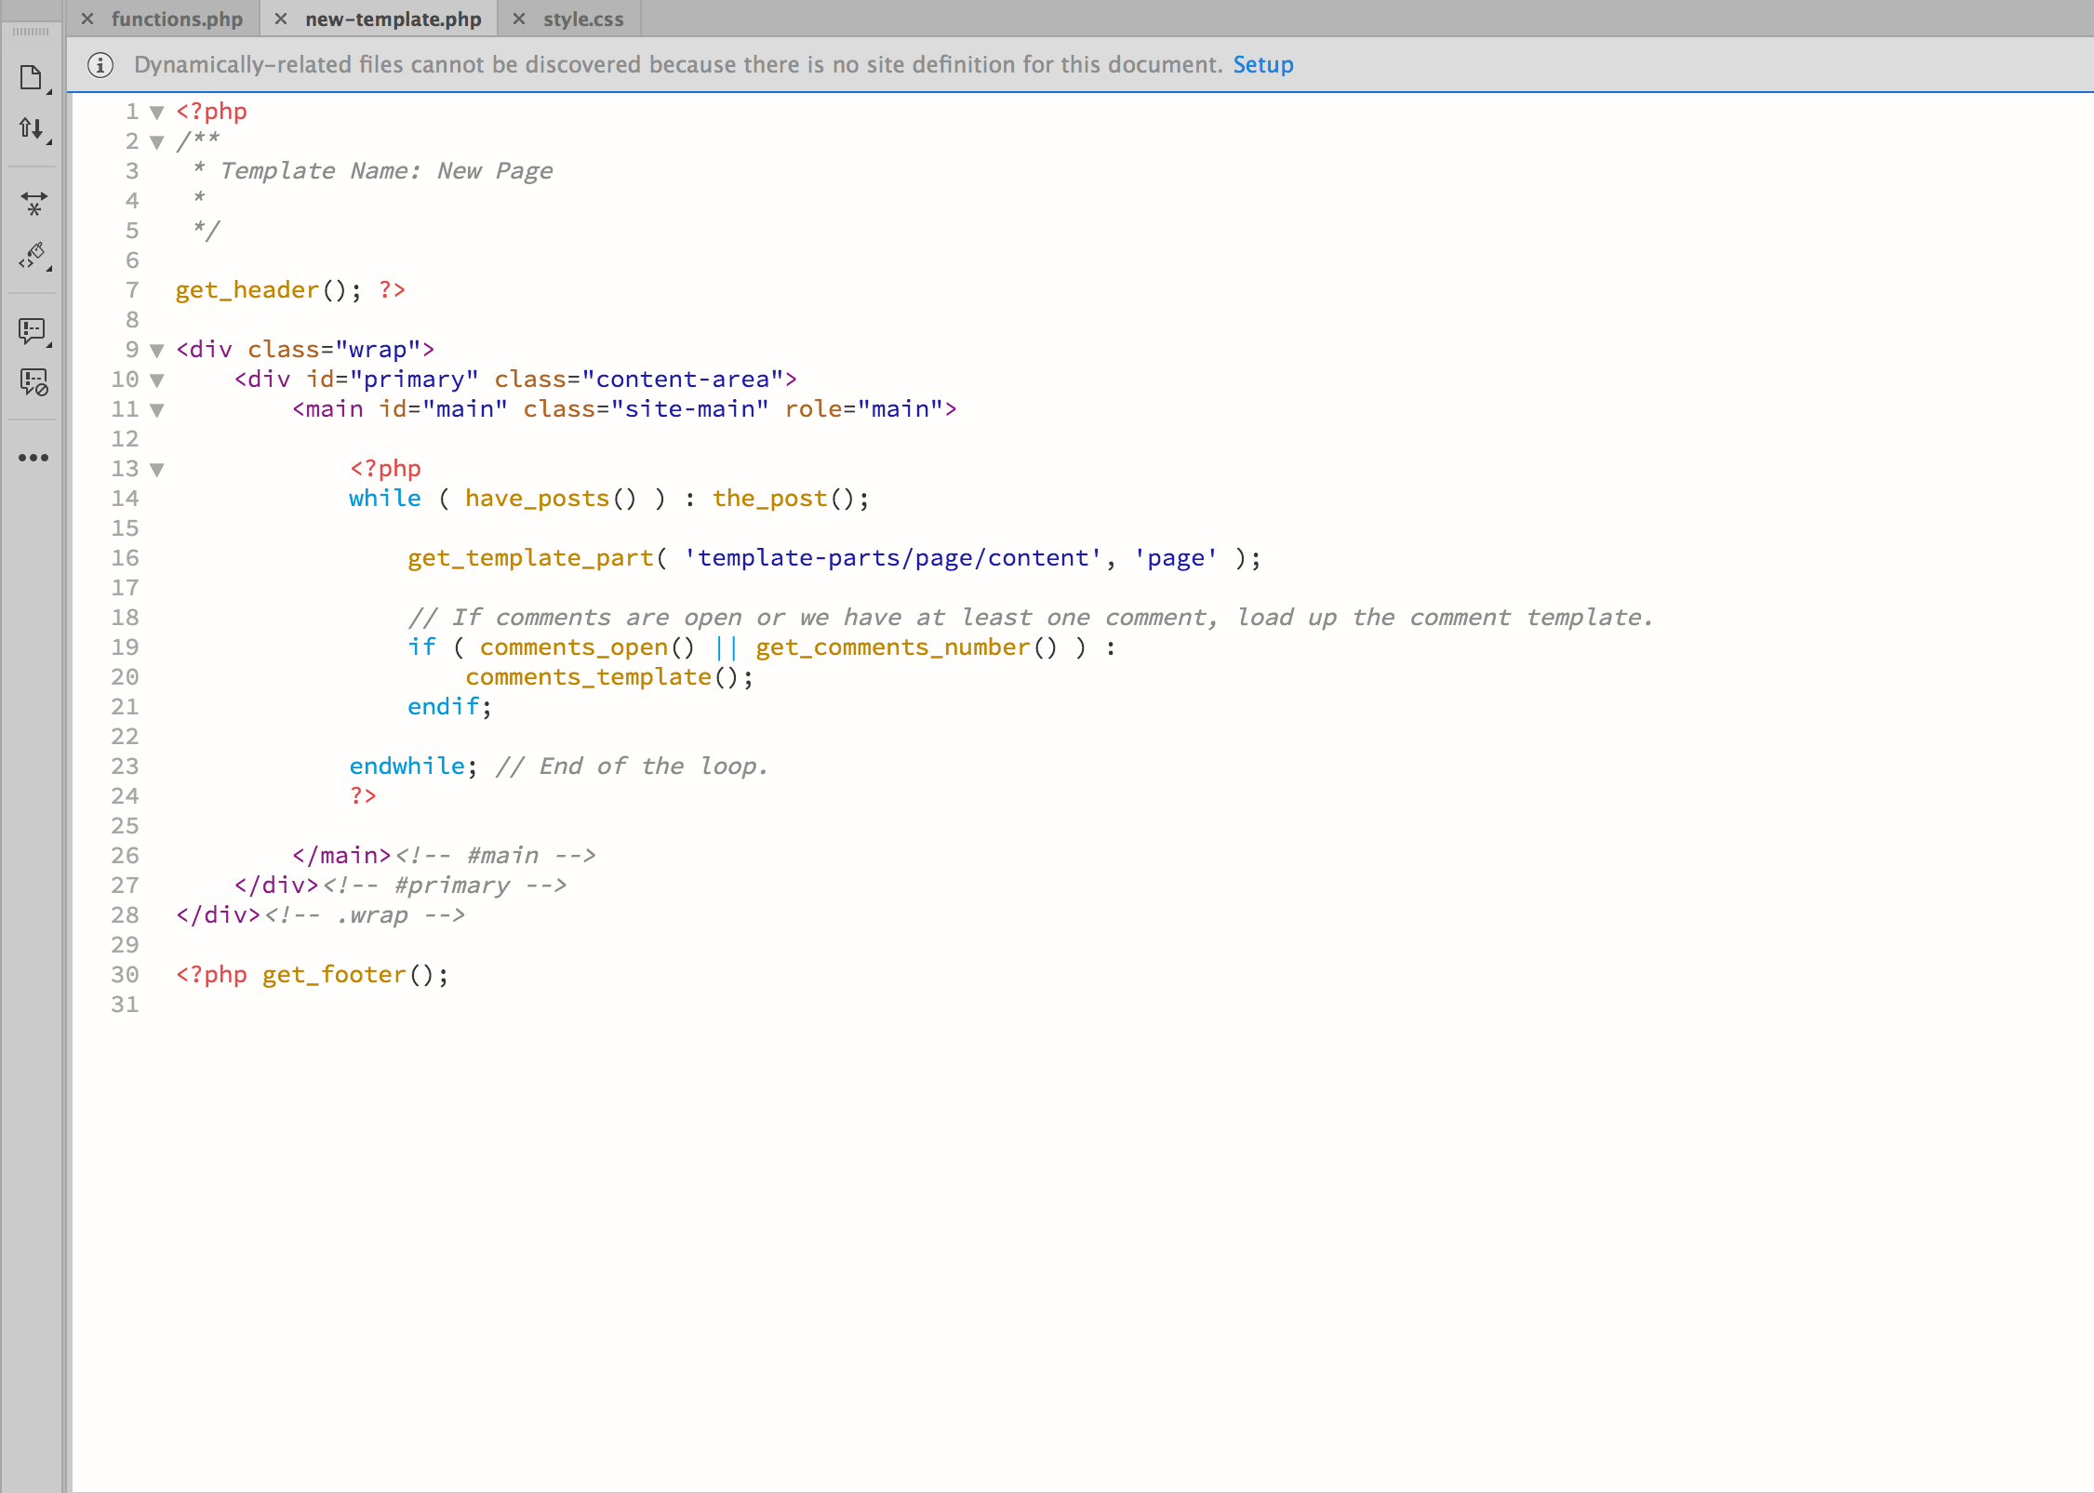

Slide 30
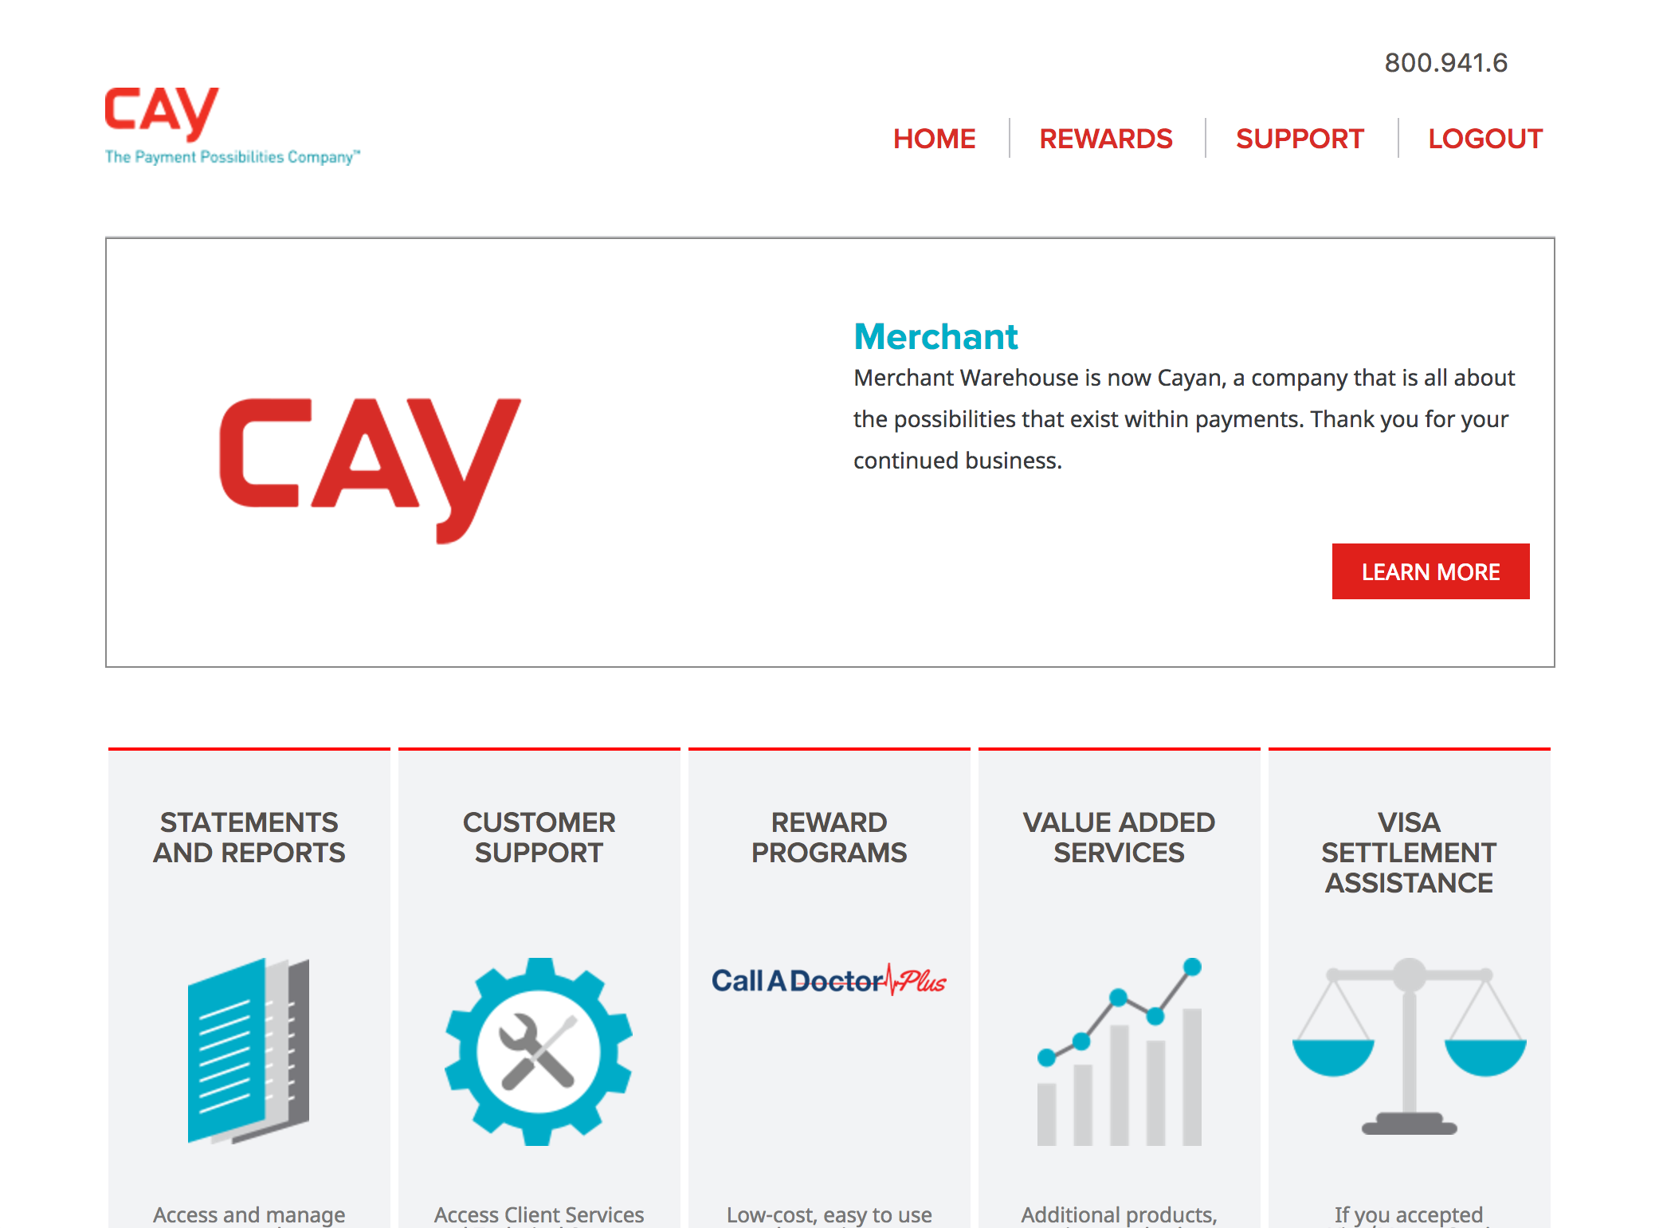

Slide 31


Slide 32
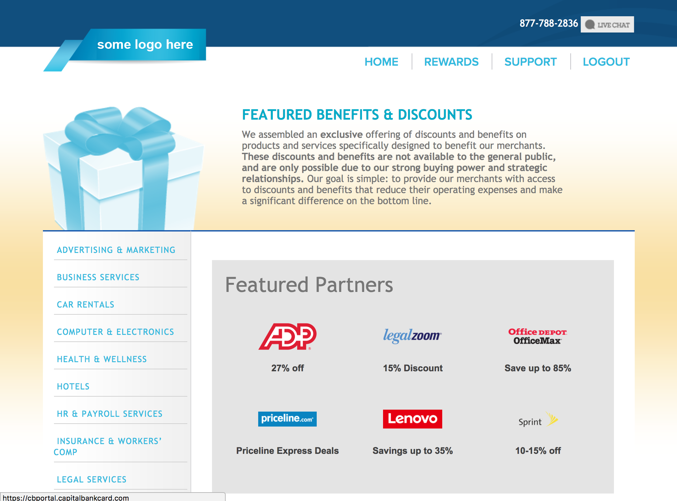


Slide 33
The WordPress Environment
Parent Theme
Theme Functions, Updates
Child Theme
Global Design

Slide 34
The WordPress Environment
Parent Theme
Theme Functions, Updates
Child Theme
Global Design
Grandchild Theme
Site-specific Functions, Design

Slide 35
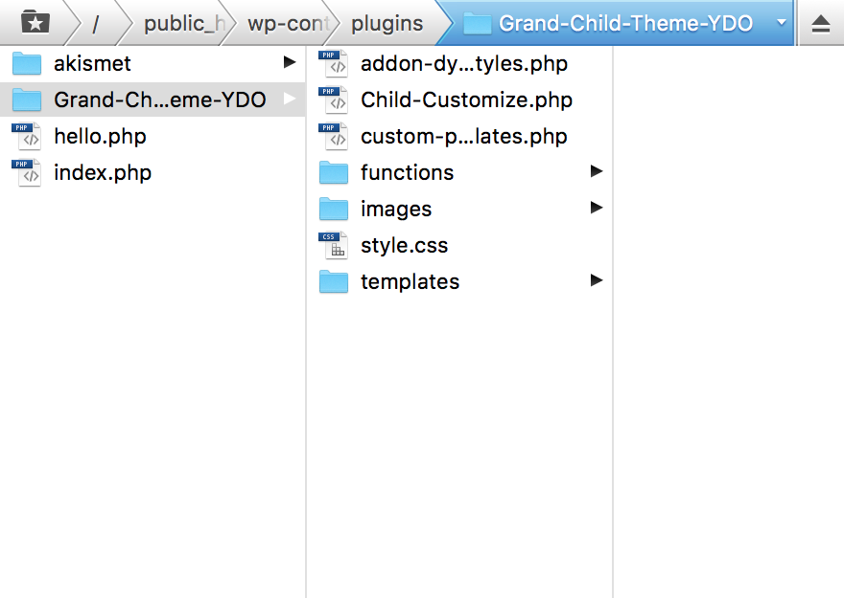

Slide 36
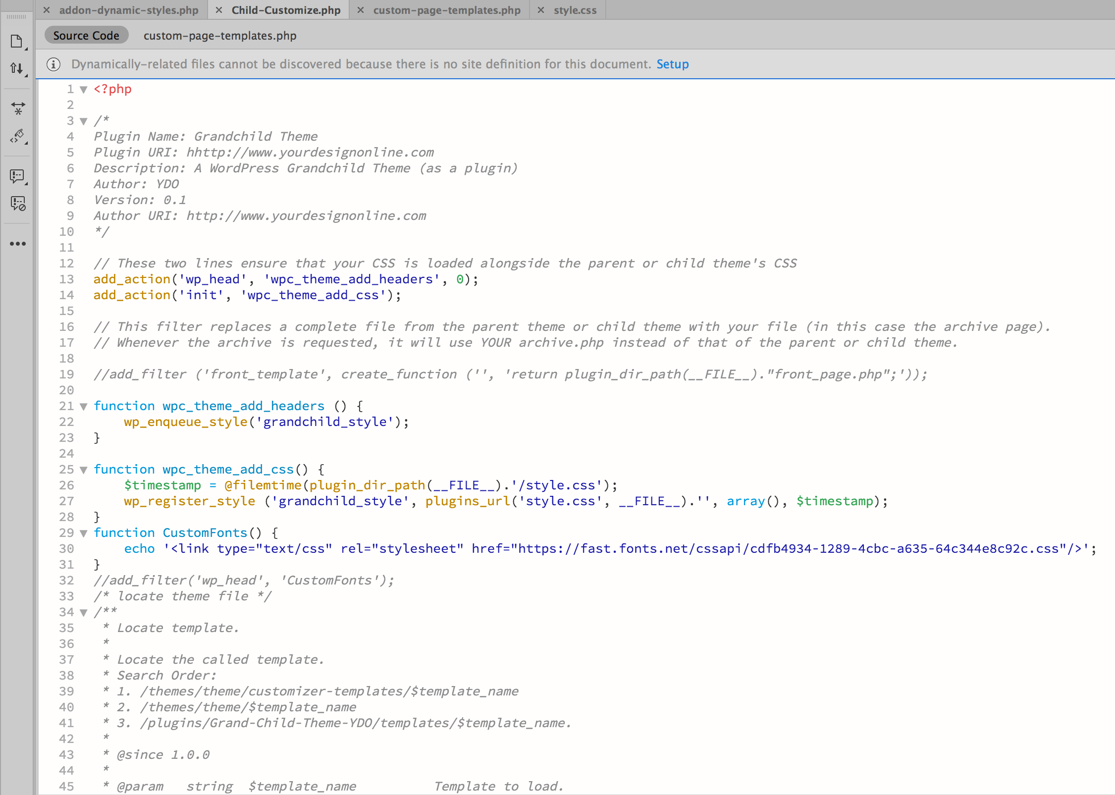

Slide 38
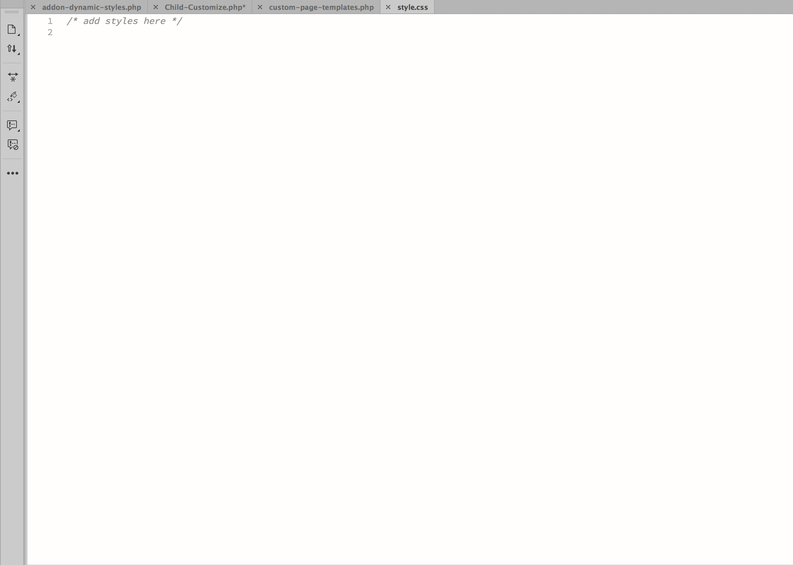

Slide 39
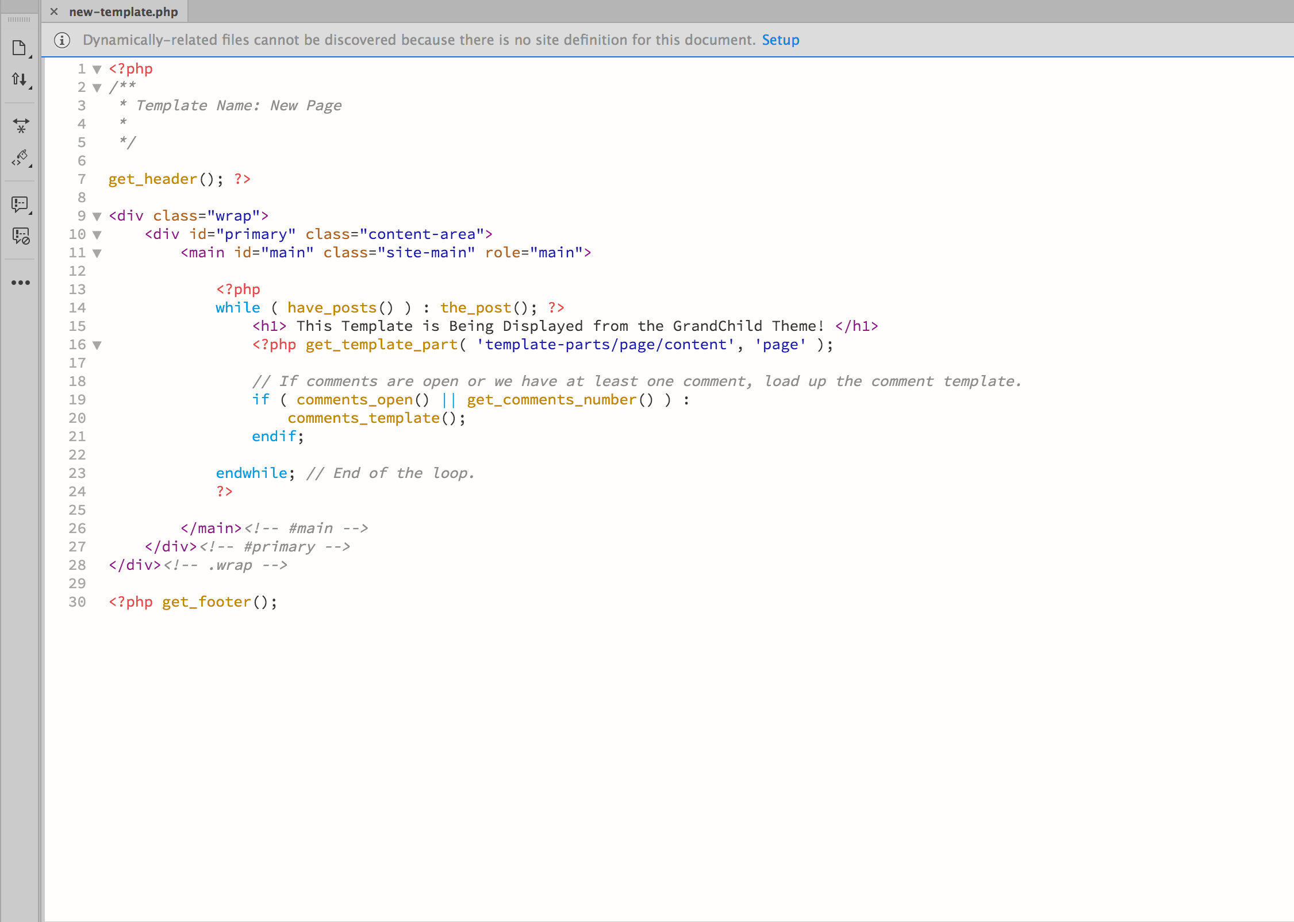

Slide 41
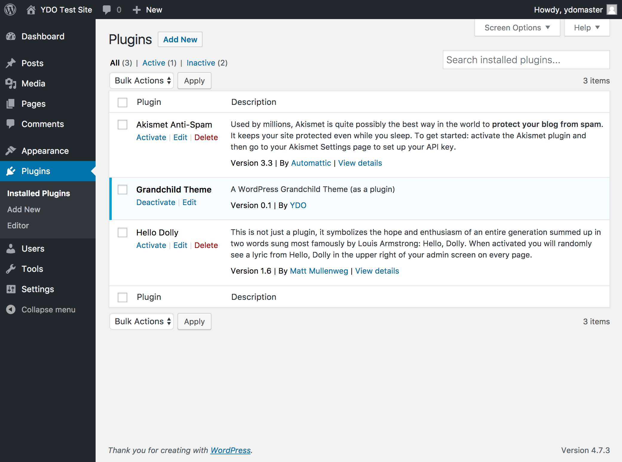

Slide 42
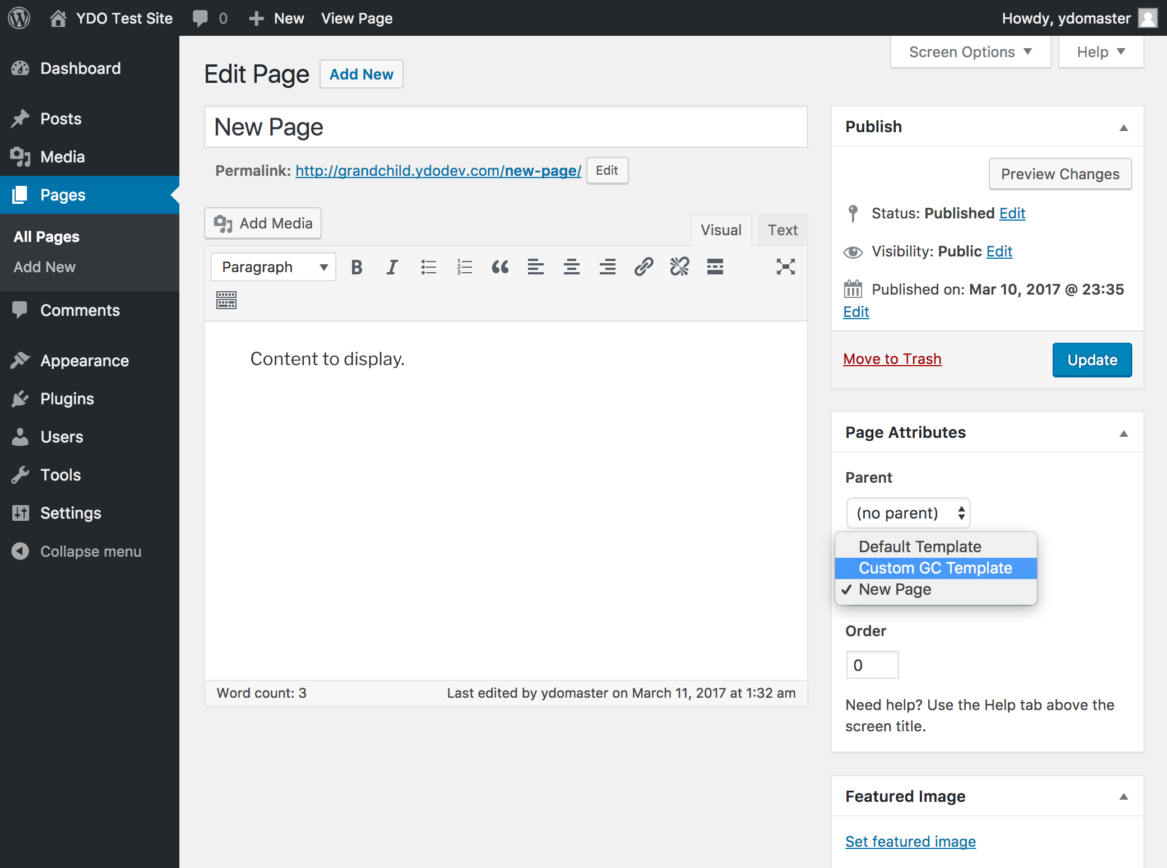

Slide 44
Our Updates Process
Main Installation (Dev and Staging)

Slide 45
Our Updates Process
Main Installation (Dev and Staging)
Our Update Plugin

Slide 46
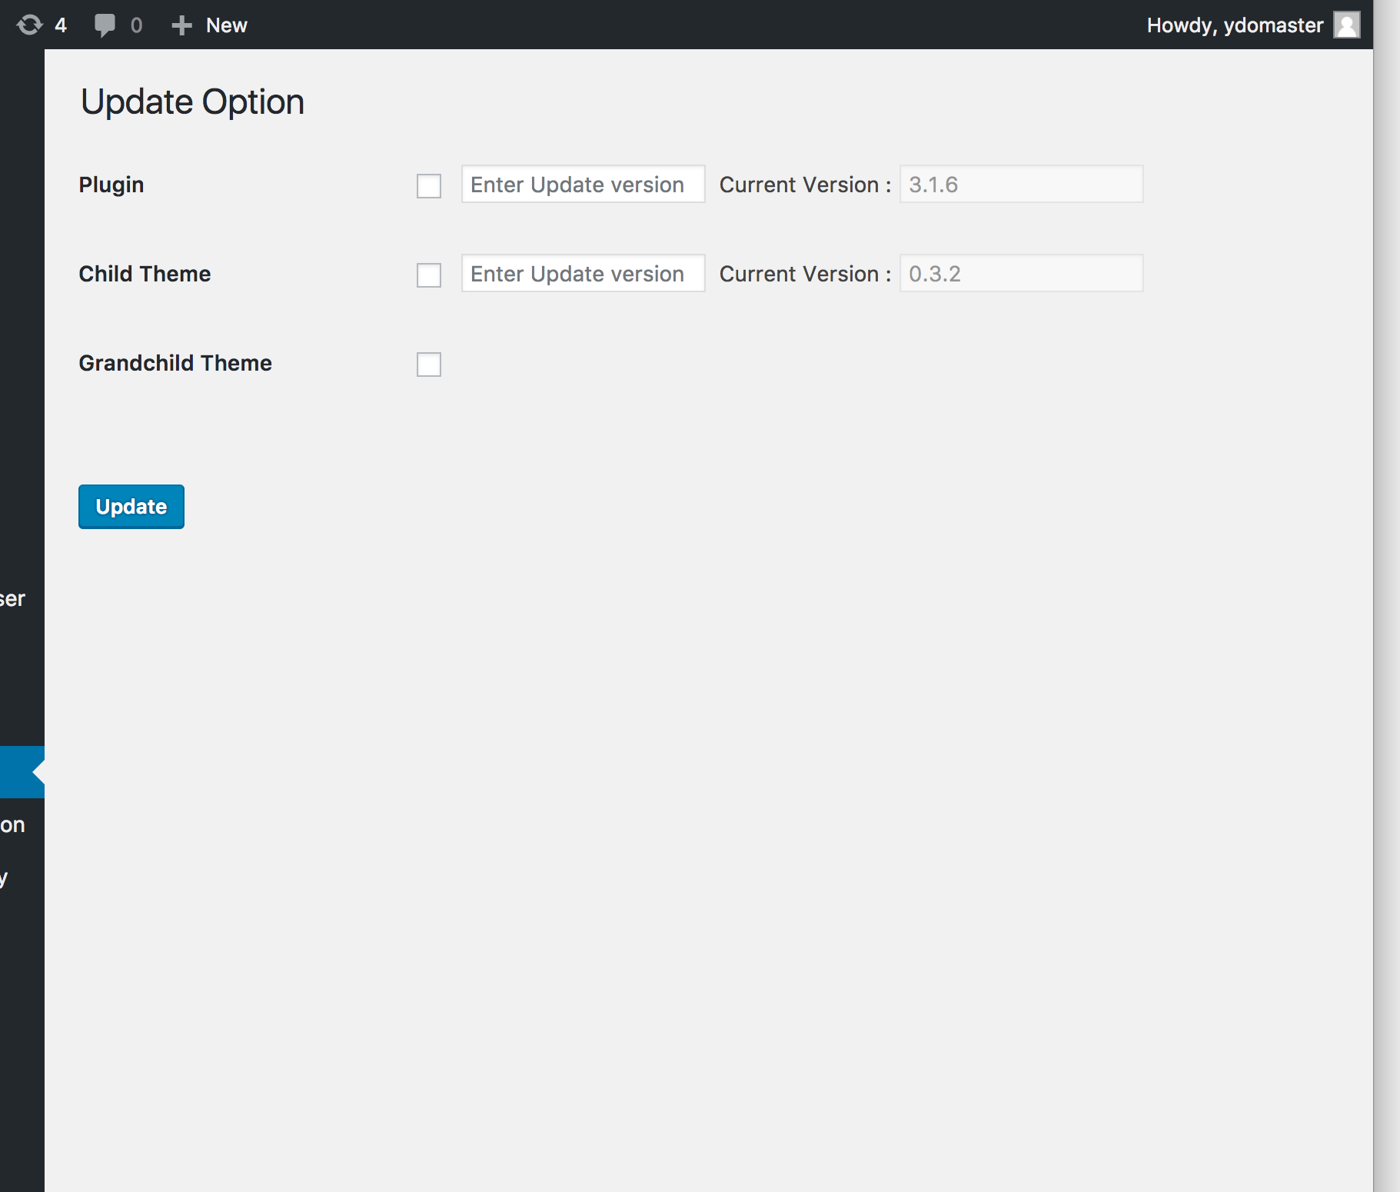

Slide 47
Another application:
Marketing Websites.

Slide 48
Common Elements
80-120 pages, clean design

Slide 49
Common Elements
80-120 pages, clean design
Multiple navigation menus

Slide 50
Common Elements
80-120 pages, clean design
Multiple navigation menus
Sliders with CTAs

Slide 51
Common Elements
80-120 pages, clean design
Multiple navigation menus
Sliders with CTAs
Content Sections: Portfolio, Team/Bios

Slide 52
Common Elements
80-120 pages, clean design
Multiple navigation menus
Sliders with CTAs
Content Sections: Portfolio, Team/Bios
Blog, Whitepapers, Resources

Slide 53
Our WordPress Environment
WordPress 2017 bundled theme

Slide 54
Our WordPress Environment
WordPress 2017 bundled theme
Our custom Child Theme

Slide 55
Our WordPress Environment
WordPress 2017 bundled theme
Our custom Child Theme
Our Grandchild Theme plugin

Slide 56
Our WordPress Environment
WordPress 2017 bundled theme
Our custom Child Theme
Our Grandchild Theme plugin
Advanced Custom Fields plugin

Slide 57
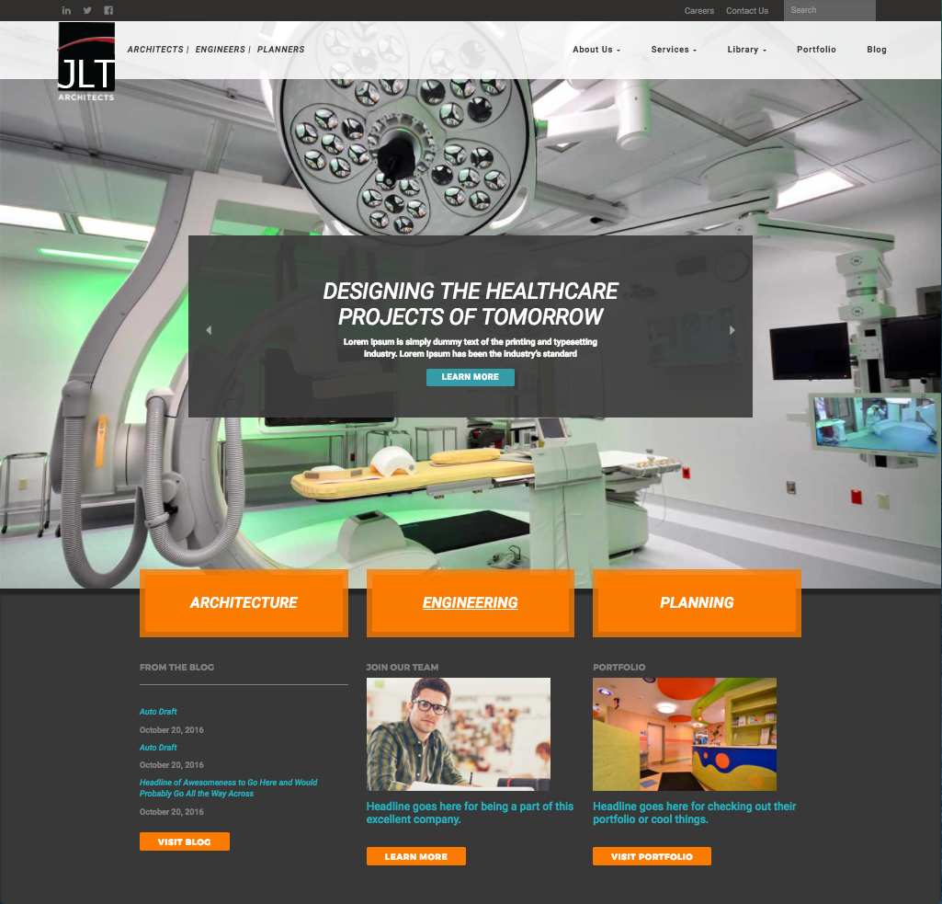

Slide 58
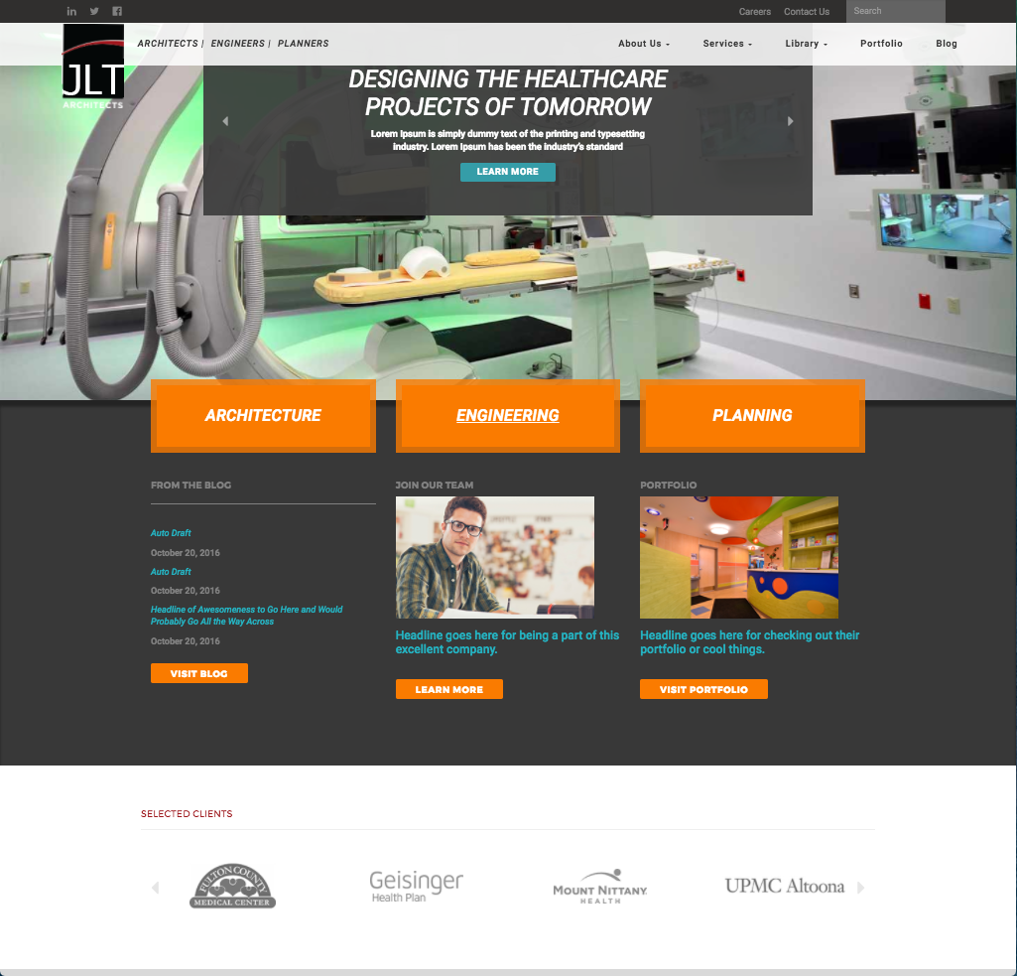

Slide 59
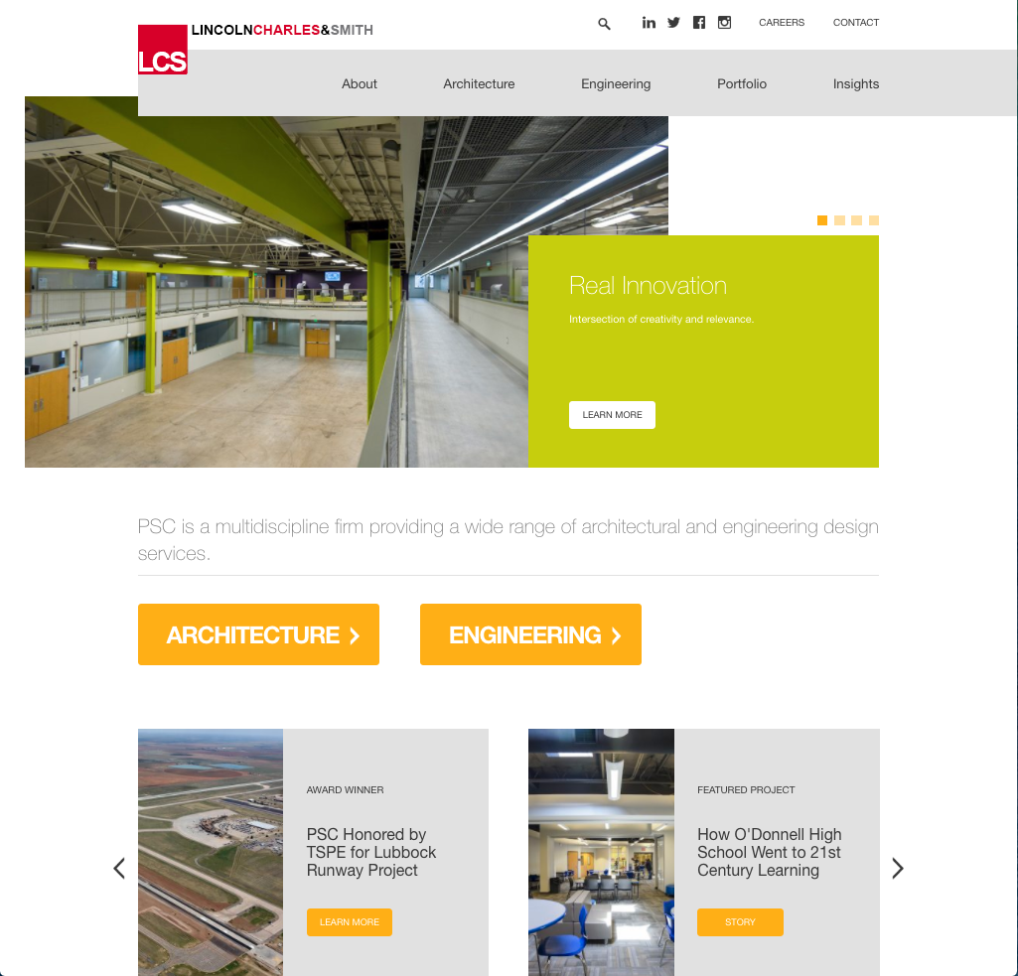

Slide 60
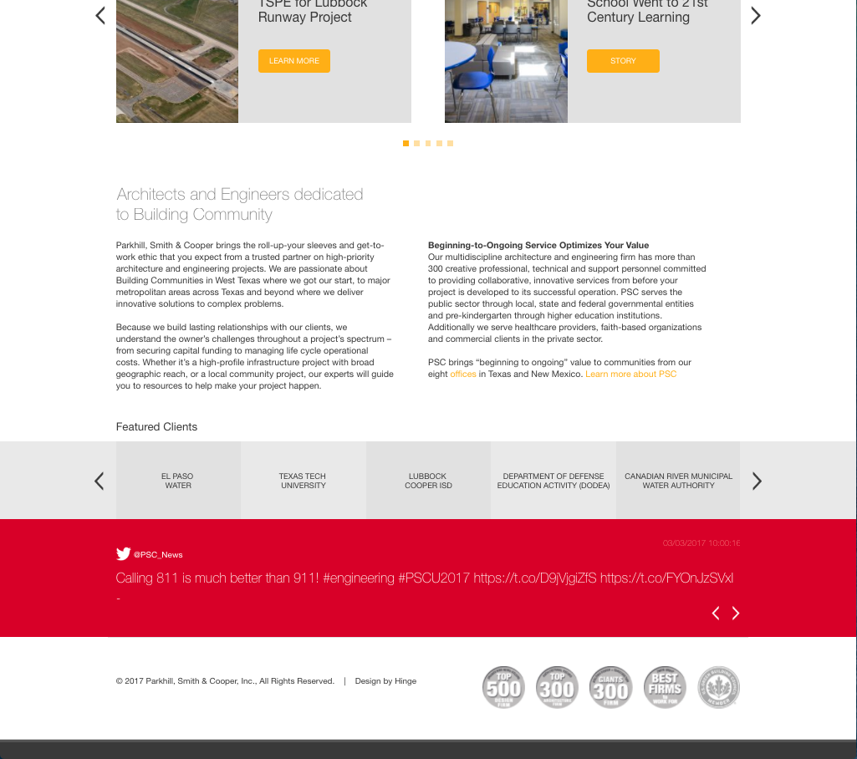

Slide 61
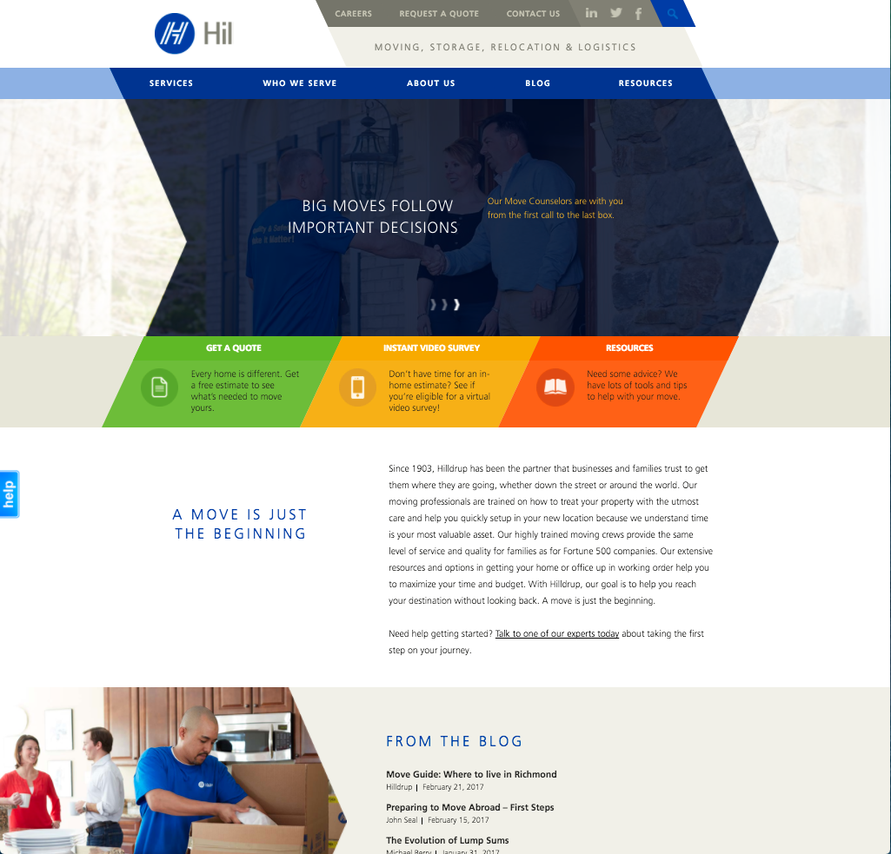

Slide 70
How to Streamline Development
Identify common elements

Slide 71
How to Streamline Development
Identify common elements
Select/Install your Parent Theme

Slide 72
How to Streamline Development
Identify common elements
Select/Install your Parent Theme
Build Child Theme to support ongoing needs

Slide 73
How to Streamline Development
Identify common elements
Select/Install your Parent Theme
Build Child Theme to support ongoing needs
Build Grandchild Theme to specific needs

Slide 74
How to Streamline Development
Identify common elements
Select/Install your Parent Theme
Build Child Theme to support ongoing needs
Build Grandchild Theme to specific needs
Build Updates process

Slide 75
The Reason:

Slide 76
The Reason:
Don’t build a website.

Slide 77
The Reason:
Don’t build a website.
Build a web product.

Slide 78
Get the Grandchild Theme Plugin.
Try it. Use it. Give Feedback. Contribute.
wc17.yourdesignonline.com

Slide 79
Keep in touch.
Questions. Feedback. Contributions.
wordcamp@yourdesignonline.com

Slide 80


